Slide 1
CARS: The Good, The Bad & The Ugly
Good = 123910809
Improvement Opportunity = CAR 123910792
Improvement #2 CAR 123910360
Good CAR #2: 123910120
Team:
Mark Jessen, Michelle Lee

Slide 2
Good CAR CAR 123910809
Requirement: The certification body shall adopt reporting procedures that suit its needs but, as a minimum, these procedures shall ensure that b) a full report on the outcome of the evaluation is promptly brought to the applicant's notice by the certification body, identifying any nonconformities that have to be discharged in order to comply with all of the certification requirements and the extent of further evaluation or testing required. If the applicant can show that remedial action has been taken to meet all the requirements within a specified time limit, the certification body shall repeat only the necessary parts of the Initial procedure
Non-Conformance: Inability to verify the calibration of the test equipment used in the conduct of the Shrinkback test under Project 11ME05471.
Objective Evidence: The datasheet package for Project 11ME05471 contained the results for a Shrinkback tests. There was not a date when the Shrinkback test was a conducted resulting in an inability to determine whether the equipment used in the conduct of the testing was calibrated at the time the testing was conducted. 19-DataSheet-1 in Supplement to Test Record in DMS when DMS searched by Project Number

Slide 3
Analysis and Root Cause
ANALYSIS - The testing staff did not record the test date for each test in the cited data sheet package. This is usually recorded on the cover page test list in the Melville W&C Lab. 5 random data sheet packages completed by R. Acevedo since 2010 were reviewed and in all cases, Raul had recorded his signature and test date for each test on the cover page, as expected. Alternatively, the test date could have been indicated by the testing staff's LPM Meter Use record for the equipment used for the test. We reviewed Archived Meter Use records for this project and confirmed that the testing staff neglected to record the heating chamber for this test instance, therefore, no definative test date can be established. Based on the Lab Job 11MEL16580 Date Assigned and Closed, testing was conducted between 10/5/2011 and 10/28/2011. The technicians 12 Meter Use records for other tests in this Project were recorded between 10/26 and 10/28/2012. Review of other LPM Jobs' Meter Use records in 2011 for the same testing staff shows 50 instances for "Shrinkback" tests, confirming that he was typically recording Meter Use for this test using a calibrated oven (see attached), therefore, this is an isolated, unintentional oversight to enter this one meter use record. We consulted with the testing staff on 8/14/2012 (he now works in VS and does not use LPM) and he was able to identify the specific oven used for this test -- Local ID ME6-100 -- a general use oven which is reserved for W&C testing staff at a fixed temperature. A "dummy" LPM Job 12MEL14162 was created and the Meter Use record was entered with an approximate test date of 10/28/2011 (the original lab job closed date). The oven was within a valid calibration window (see Milestone 1 for detail). Lab Job 11MEL16580 (2011 Archive); Notes://USNBKM701P/8625780B005EC4CE/FFE1BFD5ACEBCD91852568C5006B72B4/8625780B005EC4CE8625791F00684442 Lab Job 12MEL14162 (Melville Production DB); Notes://USMELM501/C1256E9200633250/FFE1BFD5ACEBCD91852568C5006B72B4/46FA1301322DCF1385257A5A006BE62A (See PDF attached in Containment Milestone) Based on the above, it seems that the cited nonconfirmances associated with this data sheet package were isolated incidents. For reference, this technician was assigned approx. 5 jobs per week through 2011 (249 Jobs). Stakeholders consulted: Lab Ops, Ops mgr, PH, lab tech
ROOT CAUSE Inadvertent omission of recording one piece of test equipment in LPM Meter Use Tool.
Notes:
ANALYSIS FAQ 18
CAR Owner documented the thought process data and records used to determine the cause of the nonconformance
Stakeholders consulted during the analysis were identified Why/how the defect escaped UL's process was identified as situation that was a “one off” (logic being that no system can detect every incidence of a nonconformity. It is however expected that trends be detected)
ROOT CAUSE FAQ 19
The root cause was short and logically explained the root cause based upon the analysis. Root cause was not a description of the journey to get there.
· Linkage- There was a logical connection from the requirement to the nonconformance to the root cause statement.
· Root cause stated “inadvertent omission" BUT included additional investigation which were supported by facts and data as noted in the Analysis
SCOPE of NONCONFORMANCE FAQ 17 CAR Owner concluded that the full scope and impact of the nonconformance was 11ME05471 (Objective evidence) only. Analysis supported this Scope determination as a “one off”.

Slide 4
Corrective Action
Containment – Staff Engineer confirmed in writing that it is his responsibility to “ Review the Meter Use for every project to ensure that all entries comply with the applicable requirements, and that this will be done on any current and future projects” – Confirmation attached to Containment Milestone – Discussion with Lab Tech (now works in VS) documented in CAR analysis.
Objective Evidence Resolution - LPM Project Records Update to Include Test Date (via Meter Use Entry of Oven Used); oven calibration dates – Evidence attached to Milestone
Owner verification – Review of 5 random data sheet packages completed by R. Acevedo since 2010 and found that in all cases, Raul had recorded his signature and test date for each test on the cover page. Links to reviewed projects included in Milestone

Slide 5
Improvement Opportunity CAR 123910792
Requirement: Label shall not be left with the clients. FES_P_0200100, issued 2011/10/18, Clause 5.21.11 - SI labels will be tracked in the SI label & Report Log.
Non-Conformance: SI label & Report log was not able to demonstrate that SI labels were fully tracked.
Objective Evidence:
1) Interview with Program owner and SIS Administrator and review of SI label & Report log confirms that Program owner has 80 labels, but the log indicates that there were over 400 labels in Program owner's hand. 2) There were 2 inspectors left ULC this year. There was no record in SI label & Report log to show that all labels not used have been returned to ULC.

Slide 6
Improvement Opportunity CAR 123910792
Analysis: We reviewed our labe ltracking and agreed there are flaws that need to be addressed and tighter control is required
Root Cause: Lable tracking is insufficient to determine exact labels and pinpoint when and what labels are with what engineer as there is no close out of labels when staff leave or received new labels
Scope of Nonconformance: Label tracking mechanism needs to be relooked at to determine tighter control
Notes:
Analysis – FAQ 18 used
Exact causes (“flaws” and “tighter control” cited) not identified, nor was thought process used to determine the cause(s) of the nonconformance identified Stakeholders that were consulted during the analysis not identified
Description of the records evaluated to determine the root cause not identified
Analysis of why/how the defect escaped UL's process not identified.
Spelling mistakes in Analysis
Root Cause – FAQ 19
The root cause does not explain the cause(s) and restates the symptom which was identified in the non-conformity statement as insufficient Label Tracking
Scope of Noncompliance – FAQ 17
Appears Owner misunderstood intent of Scope of Nonconformity analysis.
CAR Owner did not use this section to document the results of the investigation to determine the full scope and impact of the nonconformance. Specifically:
* How widespread was the problem?
* How was this determined?
* What areas/groups/locations have the problem based on your analysis?

Slide 7
End

Slide 8
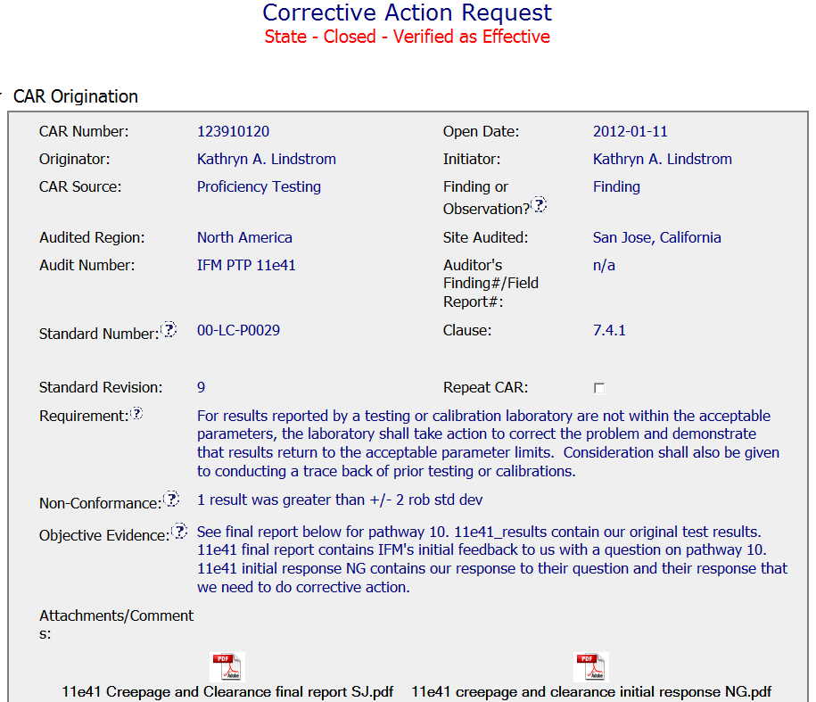
Good CAR #2
Cited the specific applicable requirement
Clear and concise non-conformity
Factual evidence from PTP report

Slide 9
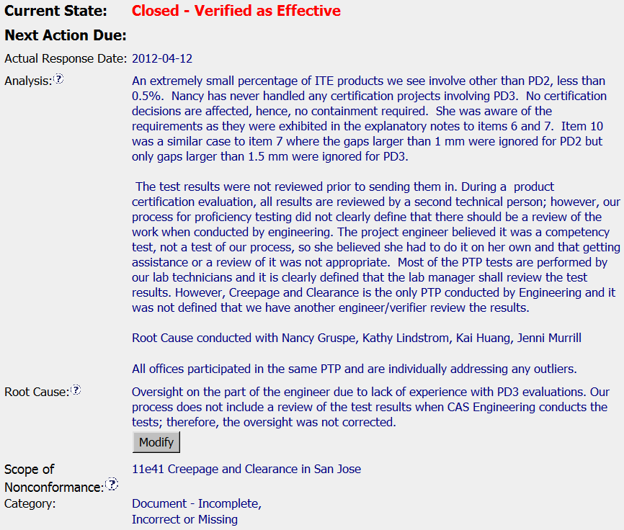
Good CAR #2
Analysis provides background for the situation:
Who, what, when, where, how and why?
Recognizes that this issue affects staff locally based on analysis
Stakeholders involved in analysis
Reasoning for why the scope is limited to local
Root cause -
No further Whys

Slide 10
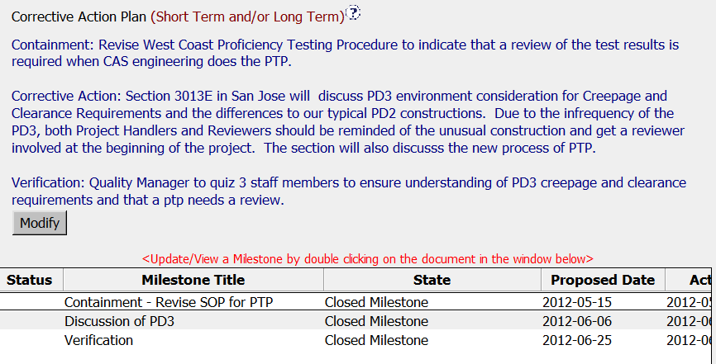
Good CAR #2
Three key components of CAP
Milestones for each CAP component

Slide 11
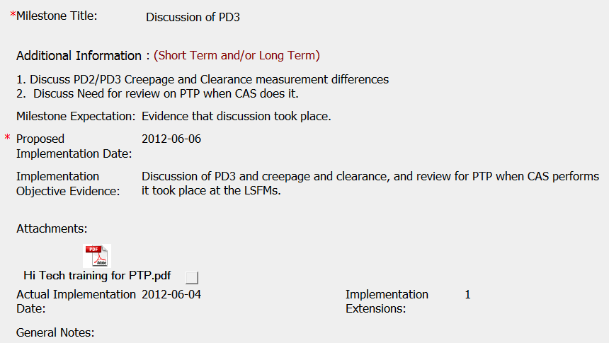
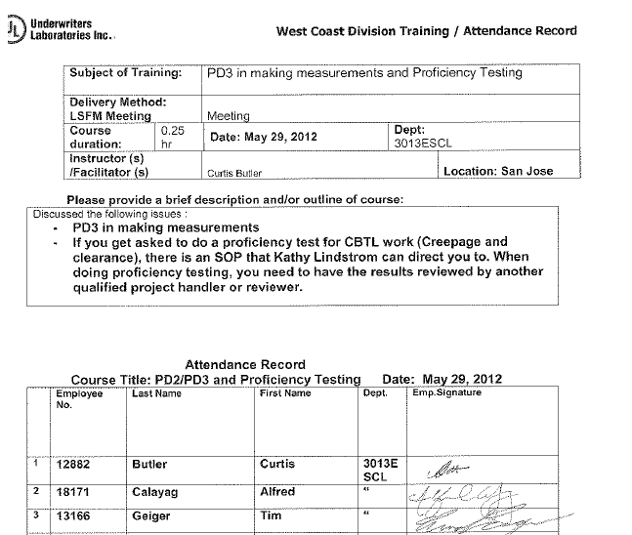
Good CAR #2
Communication with affected staff – discussion during LSFM
Copy of training record

Slide 12
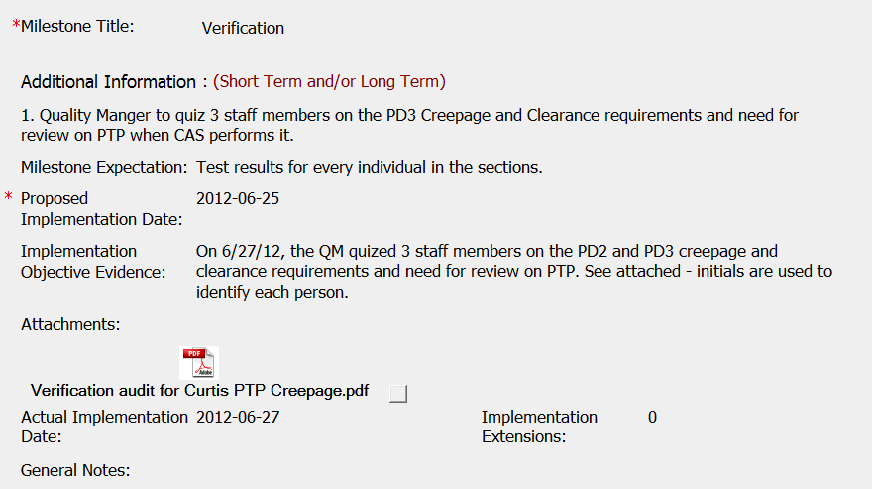
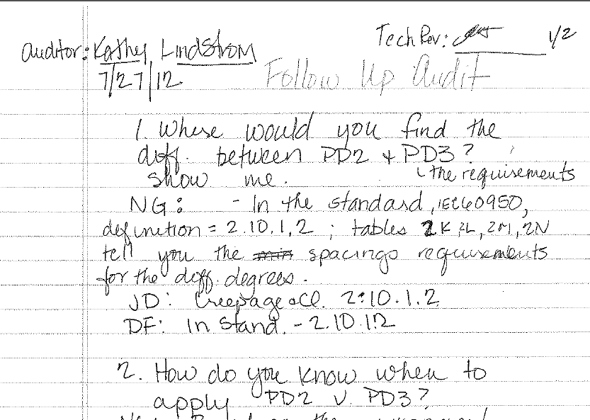
Good CAR #2
Review with affected staff to ensure training in previous milestone was indeed understood
Copy of audit notes showing results of interviews with affected staff. Used for Milestone and overall CAR verification

Slide 13
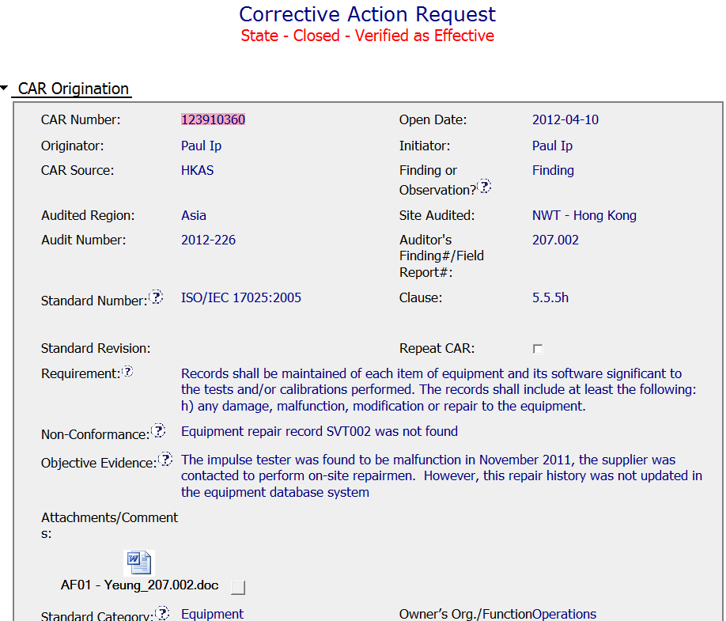
Improvement CAR #2
Cited the specific applicable requirement
No description of equipment type. Is SVT002 a global ID?
Is there only one impulse tester? How will it be identified for containment?

Slide 14
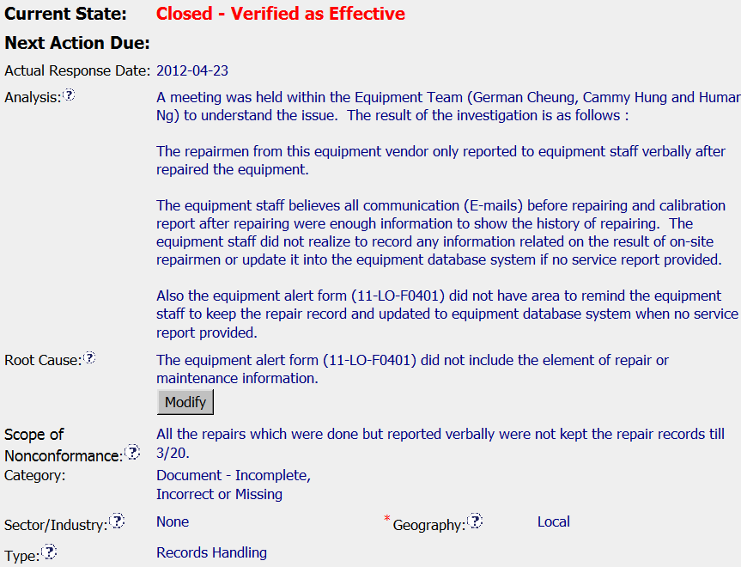
Improvement CAR #2
Who: Includes list of stakeholders
Why? What does the process doc say? Is there a form?
What is the normal practice? Was it an unusual circumstance?
Where did this occur? When did it begin?
How far back should this include? What location?

Slide 15
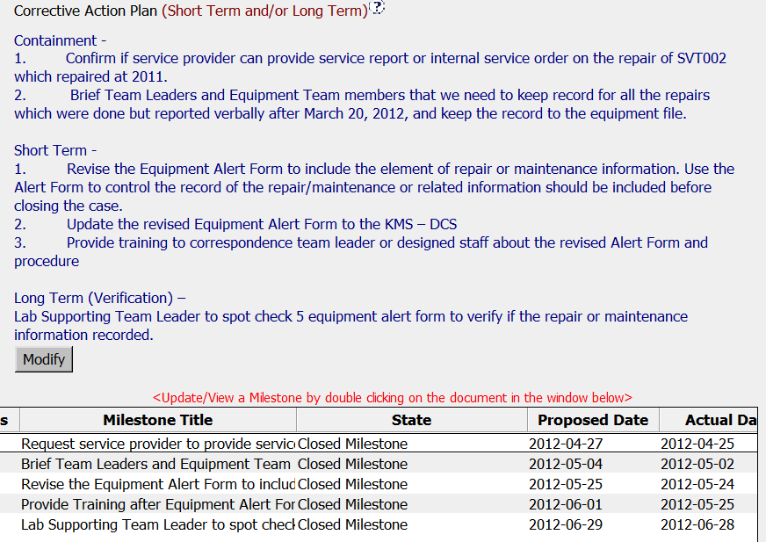
Improvement CAR #2
Three key components of CAP
Milestones for each CAP component

Slide 16
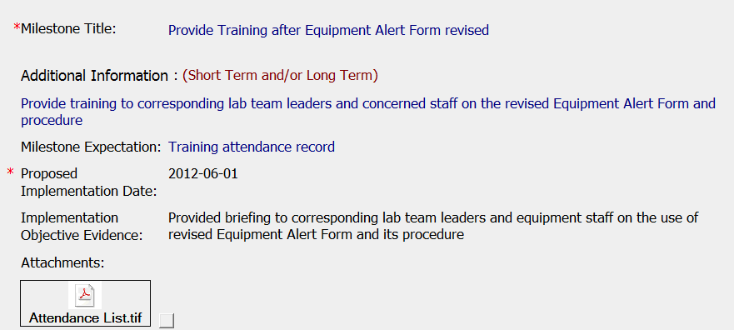
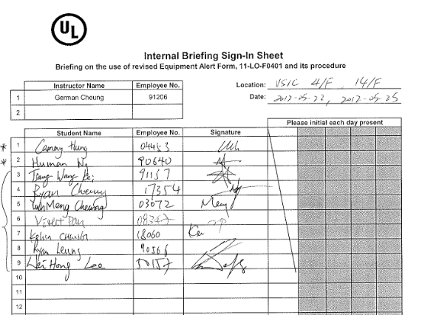
Improvement CAR #2
Is there a copy of the training material or agenda/minutes?
Copy of training record

Slide 17
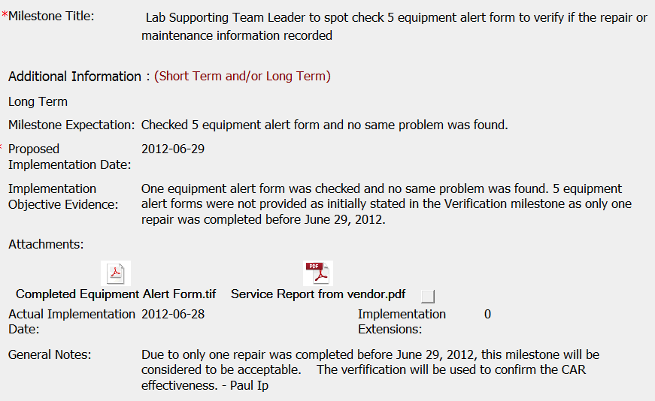
Improvement CAR #2
Would it have been possible to wait to perform verification a little later to have additional sampling?
Although only one sample was available, overall verification was completed.

Slide 18
Questions?

